Slide 1
The LionWeb Initiative
at LangDev 2023
Jos Warmer, Niko Stotz

Slide 2
Project Overview

Slide 3
Mission
To create an ecosystem of interoperable components for building language-oriented modeling tools on the web.
Adopt language engineering
Reduce vendor lock-in
Mix and match components
Foster innovation and incremental improvements

Slide 4
Why – Rationale
Most mature LWBs desktop-based
Long history
Everything needs to be web
Huge re-engineering effort
Don’t re-invent the wheel for each LWB
Focus on strengths, reuse other parts
Shared effort & multiple providers
better commercial acceptance

Slide 5
How – Principles
LionWeb as boring, reliable base
Innovate on top
Everything is a model
Markus Voelter’s Whitepaper “A Platform for Systems and Business Modeling”
Rough consensus and running code
Adopt IEEE approach
Business-friendly Open Source
Apache 2.0 license

Slide 6
What are we working on
Interoperability
meta-metamodel
serialization format
protocols
2023.1 Release
Next release
Programming APIs
Java
Kotlin
TypeScript
JavaScript
Tool integrations
MPS
Starlasa
Freon
Modelix
Ecore

Slide 7












What not – Out of Scope
Yet another Language Workbench
Plug-and-play component system
Deployment scheme
Etc. etc. etc.

Slide 8
Technical Overview

Slide 9

Reference Architecture: Parts
B
Repository
Model
Original
Derived
C
A
G
1
D
2
F
E
Clients
Editor
Processors
Model checker
Importer
Generator
A
B
JSON &
protocols
F
G
C
D
E

Slide 10
Reference Architecture: Protocols
1
5
2
4
3
Bulk
Load model, modify, store it back
Load, derive something else
Delta
Initialise with model, get notified of changes, write back changes continuously
2
5
1
4
3

Slide 11
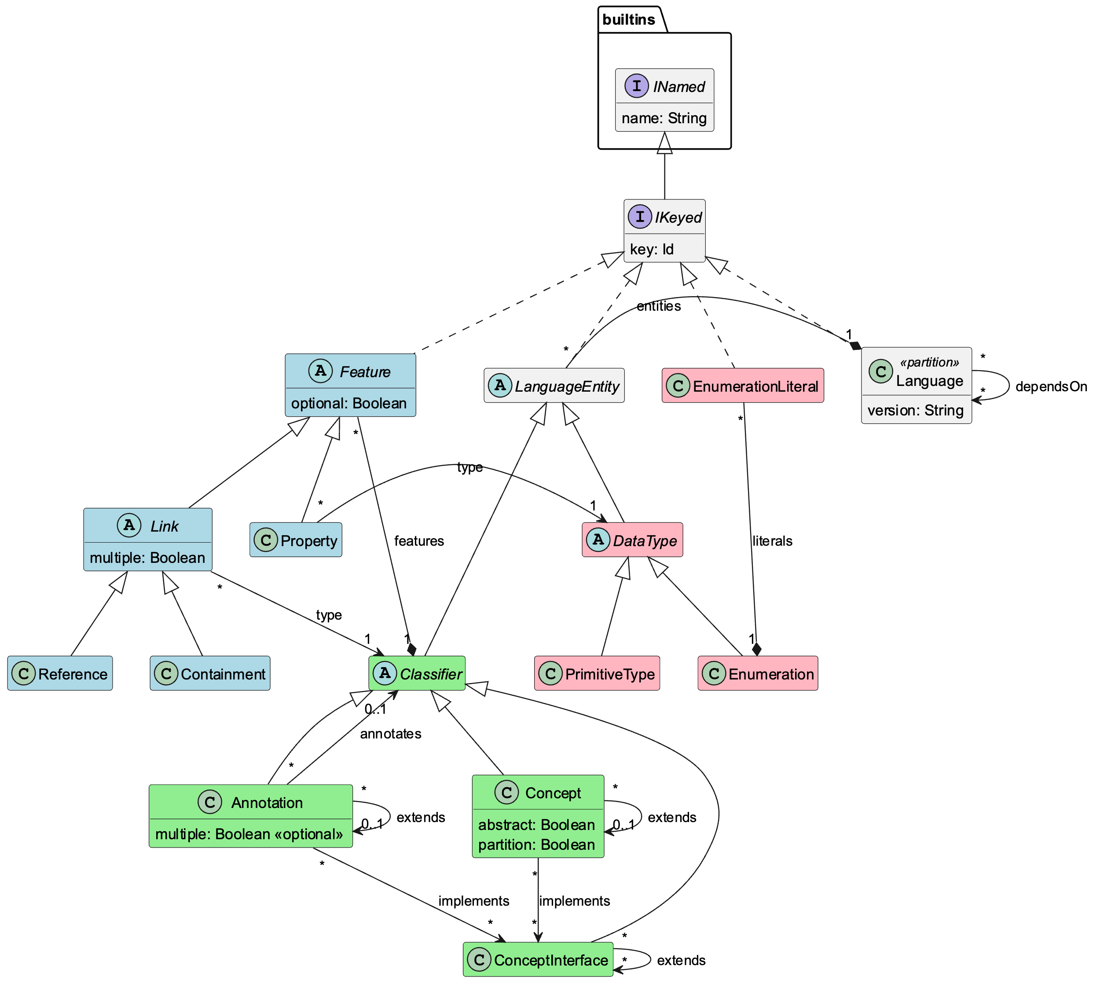
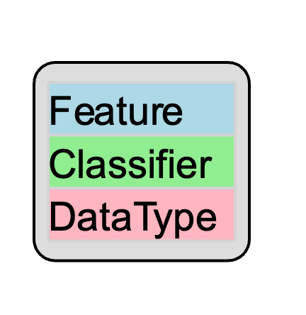
Meta-Metamodel

Slide 12
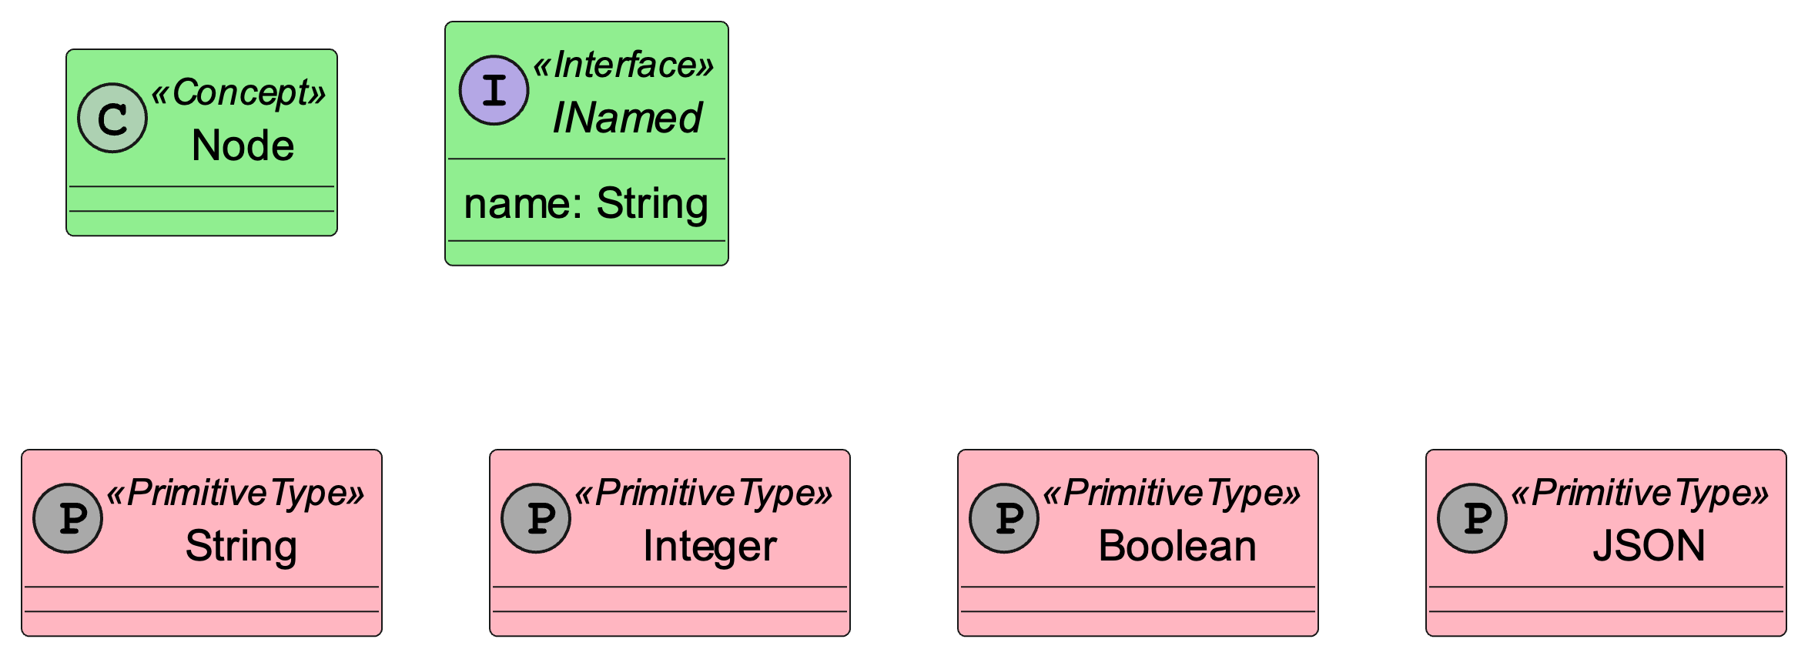
Built-in Meta Model Standard Library

Slide 13
Showtime

Slide 14
Freon Editor for LionWeb MetaModels
Demo flow
Changed
Properties file
7
Properties file
1
Kotlin Converter
Kotlin PROP
classes
Kotlin PROP Application
PROP LionWeb
Instance.json
6
2
MPS Converter
MPS PROP Language
MPS with PROP language
LionWeb PROP metamodel
3
5
Freon Converter
Freon PROP language
Freon PROP Web Editor
4
Ecore PROP language + Xtend
HTML Page
with PROP instance
Ecore Converter
Ecore PROP language

Slide 15
Meta / Language Demo flow
Kotlin Converter
Kotlin PROP
classes
Kotlin PROP Application
MPS Converter
MPS PROP Language
MPS with PROP language
Freon Editor for LionWeb MetaModels
LionWeb PROP metamodel
Freon Converter
Freon PROP language
Freon PROP Web Editor
Ecore Converter
Ecore PROP language
Ecore PROP language + Xtend

Slide 16
Freon Editor for LionWeb MetaModels
Meta / Language Demo flow
LionWeb PROP metamodel
Kotlin Converter
MPS Converter
Freon Converter
Ecore Converter
Kotlin PROP
classes
MPS PROP Language
Freon PROP language
Ecore PROP language
Kotlin PROP Application
MPS with PROP language
Freon PROP Web Editor
Ecore PROP language + Xtend

Slide 17
1
Properties file
Model Demo flow
Kotlin PROP Application
8
Changed
Properties file
2
7
PROP LionWeb
Instance.json
3
MPS with PROP language
Ecore PROP language
HTML Page
with PROP instance
4
5
Freon PROP Web Editor
6

Slide 18
Demo Contents
Generate LIonWeb metamodel from Kotlin classes
Parse properties file and store as LIonWeb instance model
Import metamodel into MPS
Convert to MPS languages
Import properties instance model into MPS
Show instance model in Freon web editor, served from MPS via LIonWeb protocol
Change some values in Freon
Store changes back to MPS
Export example instance from MPS to LIonWeb
Unparse example instance

Slide 19

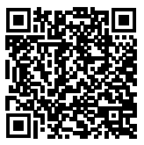
Who – Participation
Meinte Boersma | Freelancer
Norman Koester | itemis (modelix)
Sergej Koscejev | Freelancer
Sascha Lisson | itemis (modelix)
Eugen Schindler | Canon Production
Alex Shatalin | Jetbrains (MPS)
Niko Stotz | F1RE
Federico Tomassetti | Strumenta (Starlasu)
Markus Voelter | itemis (modelix)
Jos Warmer | Freelancer (Freon)
https://join.slack.com/t/lionweb/shared_invite/zt-1uvaly9eb-z529c694OIN5oBh9FH1vhQ
info@lionweb.io

Slide 20
LionWeb Team
Meinte Boersma | Freelancer
Norman Koester | itemis (modelix)
Sergej Koscejev | Freelancer
Sascha Lisson | itemis (modelix)
Eugen Schindler | Canon Production
Alex Shatalin | Jetbrains (MPS)
Niko Stotz | F1RE
Federico Tomassetti | Strumenta (Starlasu)
Markus Voelter | itemis (modelix)
Jos Warmer | Freelancer (Freon)
Want to join and work with us:
info@lionweb.io
Want to follow us or use LionWeb:
https://join.slack.com/t/lionweb/shared_invite/zt-1uvaly9eb-z529c694OIN5oBh9FH1vhQ

Slide 21
Near Term Focus
Finalize Bulk Protocols and document them
Start Work on delta protocols / collaboration
Refine meta-metamodel
Improve reference implementations and examples
Support integration with more tools

